Slide 1


Graduation
Requirements
El Paso Independent School District
House Bill 5
Notes:
Welcome and introductions
Purpose of meeting
The presentation of HB5 graduation requirements
All current 8th grade students, parents, and their counselor need to sign their endorsement declaration letters
EPISD graduation plan is pending Board approval May 20

Slide 2

2012-2013 Texas Legislature,
House Bill 5
Approved to reshape the graduation plans for all students in the state of Texas.
Students choose their high school Program of Study
Beginning with students entering 9th grade in 2014-2015
5 Endorsement areas:
MULTIDISCIPLINARY STUDIES
ARTS & HUMANITIES
BUSINESS & INDUSTRY
PUBLIC SERVICES &
STEM (SCIENCE, TECHNOLOGY, ENGINEERING &MATHEMATICS)
  EPISD currently offers courses to satisfy all Five Endorsements

Slide 3

Graduation Plans
HB5
9th grade 2013-14 and prior
9th grade 2014-15 and thereafter
Minimum
Recommended
Distinguished Achievement Plan (DAP)
Foundation
Endorsement
Distinguished Level
of Achievement
Endorsements
  (Distinguished Level of Achievement)
  STEM
  Arts & Humanities
  Business & Industry
  Public Services
  Multi-Disciplinary

Slide 4

English 1
English 2
English 3
Advanced English
Algebra 1
Geometry
Algebra 2
Advanced Mathematics
World History or World Geography
US History
Government
Economics
Biology I
One Adv. Science Course, Category 1
Two Adv. Science Courses, Category 2
EPISD
Core Concentration
Foundation

Slide 5
EPISD
Required Elective
Foundation (Continued)
Technology Credit
1.0 Credit
Fine Arts Same Genre
1.0 Credit
Communication Apps. OR
Professional Communication
.5 Credits
0.5 Health OR
1.0 Lifetime Nutrition
& Wellness OR
1.0 Health Science I
P.E. or P.E Equivalent
1.0 Credit
Languages Other Than English
Same Language
2.0 Credits
Elective Credit
0.5 to 1.0 Credit

Slide 6
EPISD HB 5 Foundation Graduation Requirements
With Endorsement and Distinguished Level of Achievement
Courses | Credits | 9th | 10th | 11th | 12th
English | 4 | English I | English II | English III | Advanced English
Math | 4 | Algebra I | Geometry | Two Advanced Math** Courses One of Which Must Be Algebra II
Science | 4 | Biology | Advanced Science | Advanced Science | Advanced Science
Social Studies | 3 | World Geography and/or World History |  | US History | Government & Economics
Fine Arts | 1 | 1.0 credit at any grade level (Same Genre)
Languages (LOTE) | 2 | 2.0 credits in the same language at any grade level
P.E. or P.E. Equivalent | 1 | 1.0 credit at any grade level
Speech | .5 | Communication Apps. OR Professional Communication (grades 10-12)
Health | .5 | 0.5 Health OR *(1.0 Lifetime Nutrition OR 1.0 Health Science)
Technology | 1 | 1.0 credit at any grade level
Electives | 0.5 to 1.0
EPID Foundation Total | 22
Endorsement | 4
Total | 26
*Uses 0.5 credit elective
**Most advanced math require Algebra II as prerequisite
Notes:
Most of the advanced math courses require Algebra II as a prerequisite

Slide 7

ARTS AND HUMANITIES ENDORSEMENT OPTIONS
Foundation (22 Credits) + Endorsement (4.0 Credits) = 26 Credits
Academic
Distinguished Level of Achievement
Endorsement (E)
English Language Arts
EPISD
Foundation And
Endorsement (A)
Social
Studies
EPISD
Foundation And
Endorsement (B)
LOTE
Languages Other Than English
Same Language
EPISD
Foundation And
Endorsement (C)
LOTE
Languages Other Than English Different Language
EPISD
Foundation And
Endorsement (D)
Fine Arts
EPISD Foundation And
4 English elective credits by selecting from the following:
English IV, Ind. Study in English, Lit. Genres, Creative Writing, Research & Tech Writ., Humanities, AP Eng. Lit. & Composition; or IB Lang. Studies A1 Higher Level; or Comm. Applications
4.0 Credits
1.0 Human Geography AP,
1.0 Additional Social Studies,
1.0 Art History
1.0 Additional Elective
4.0 Credits
Third and fourth level of the same language other than English and two additional electives
4.0 Credits
Two levels of an additional language other than English, and two additional electives
4.0 Credit
A coherent sequence of 4 credits by selecting from 1 or 2 categories or disciplines in fine arts
4.0 Credit

Slide 8
BUSINESS & INDUSTRY ENDORSEMENT OPTIONS
Foundation (22 Credits) + Endorsement (4.0 Credits) = 26 Credits
Career & Technical Education
Distinguished Level of Achievement
Academic
Distinguished Level of Achievement
Endorsement (A)
CAREER & TECHNICAL EDUCATION
EPISD Foundation And
Endorsement (B)
ENGLISH
EPISD Foundation And
Endorsement (C)
TECHNOLOGY
APPLICATIONS
EPISD Foundation And
Endorsement (D)
BUSINESS
COMBINATION
EPISD Foundation And
A coherent sequence of courses for 4 or more credits in CTE that consists of at least 2 courses in the same career cluster including at least one advanced CTE course which includes any course that is the third or higher course in a sequence. That final course must be from one of the following clusters:
Agriculture, Food & Natural Resources, Architecture & Construction, Arts, Audio/Video Technology, & Communication, Business Management Administration, Finance, Hospitality & Tourism, Information Technology, Manufacturing, Marketing, or Transportation.
4.0 Credits
Three Levels of Public Speaking OR
Three Levels of Debate OR
Three Levels of Adv. Journ. Newspaper OR
Three Levels Adv. Journ. Yearbook
& 1 English elect.
4.0 Credit
4 technology applications credits by selecting from: Digital Design, Digital Art, 3-D Modeling, Digital Communications, Digital Video, Web Communications, & Design, Gaming
4.0 Credits
4 Credits From any Business and Industry Endorsement; (A), (B), or (C)
4.0 Credits

Slide 9
F
SCIENCE, TECHNOLOGY, ENGINEERING & MATHEMETICS
Foundation (22 Credits) + Endorsement (4.0 Credits) = 26 Credits
Career & Technical Education
Distinguished Level of Achievement
Academic
Distinguished Level of Achievement
Endorsement (A)
CAREER & TECHNICAL EDUCATION
EPISD Foundation And
Endorsement(B)
STEM
COMPUTER SCIENCE
EPISD Foundation &
Endorsement (C)
STEM
MATHEMATICS
EPISD
Foundation &
Endorsement (D)
STEM
SCIENCE
EPISD
Foundation &
Endorsement(E)
STEM
COMBINATION
EPISD
Foundation &
A coherent sequence of courses for 4 or more credits in CTE that consists of at least 2 courses in the same career cluster including at least one advanced CTE course which includes any course that is the third or higher course in the CTE STEM career cluster.
4.0 credits
A coherent sequence of four credits in computer sci. selected from: Technology Applications
4.0 credits
An advanced math course for which Alg. 2 is a prerequisite totaling 5 credits in math, and an additional 3 electives
4.0 Credit
An additional advanced science credits from category 2 totaling five credits in science, and an additional 3 electives
4.0 Credit
In addition to Algebra II, chemistry, and physics, a coherent sequence of 3 credits from no more than 2 of the areas listed in (A), (B), (C), & (D) 1 add. elective
4.0 Credit

Slide 10

PUBLIC SERVICES ENDORSEMENT OPTIONS
Foundation (22 Credits) + Endorsement (4.0 Credits) = 26 Credits
Career & Technical Education
Distinguished Level of Achievement
Academic
Distinguished Level of Achievement
Endorsement (B)
Junior Reserve Officer Training Corps (JROTC)
EPISD Foundation
And
Endorsement (A)
CAREER & TECHNICAL EDUCATION
EPISD Foundation And
A coherent sequence of courses for 4 or more credits in CTE that consists of at least 2 courses in the same career cluster including at least one advanced CTE course which includes any course that is the third or higher course in a sequence. That final course must be from one of the following clusters:
The final course must be from one of the Following clusters: Education & Training, Government and Public Administration, Health Science, Human Services, Law, Public Safety, Corrections, and Security
4.0 Credits
Four credits in the Junior Reserve Officer Training Corps (JROTC).
4.0 Credits
Notes:
A student may earn a public services endorsement by completing EPISD foundation and general endorsement requirements and:
A coherent sequence courses for four or more credits in CTE that consists of at least two courses in the same career cluster including at least one advanced CTE course which includes any course that is the third or higher course in a sequence. The courses may be selected from courses in all CTE career clusters or CTE innovative courses. The final course in the sequence must be selected from one of the following CTE career clusters:
Education and Training
Government & Public Administration
Health Science
Human Services
Law, Public Safety, Corrections & Security
Four Credits in Junior Reserve Officer Training Corps (JROTC)

Slide 11
MULTIDISCIPLINARY ENDORSEMENT OPTIONS
Foundation (22 Credits) + Endorsement (4.0 Credits) = 26 Credits
Career & Technical Education
Distinguished Level of Achievement
Academic
Distinguished Level of Achievement
Endorsement (A)
Workforce
Post-Secondary Education
EPISD
Foundation And
Endorsement (B)
Core Concentration
EPISD
Foundation And
Endorsement (C)
Advanced
EPISD
Foundation And
Four advanced courses that prepare a student to enter the workforce successfully or postsecondary education without remediation from within one endorsement area or among endorsement areas that are not in a coherent sequence
4.0 Credits
Four credits to include one additional social studies and three elective credits
4.0 Credit
Four credits to include a fourth social studies: Advanced Placement, (AP) OR International Baccalaureate (IB) OR Dual Credit (DC)
Courses can be elected from English, mathematics, science, social studies, economics, languages other than English, or fine arts.
4.0 Credits

Slide 12
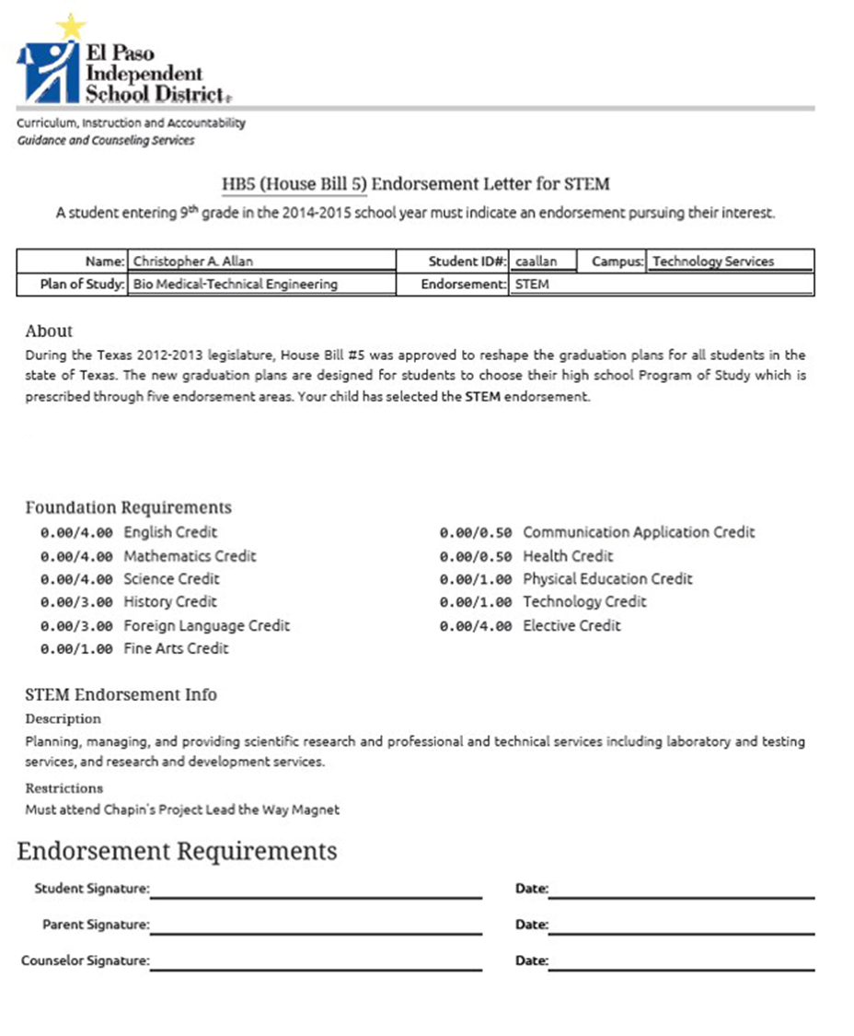

Slide 13
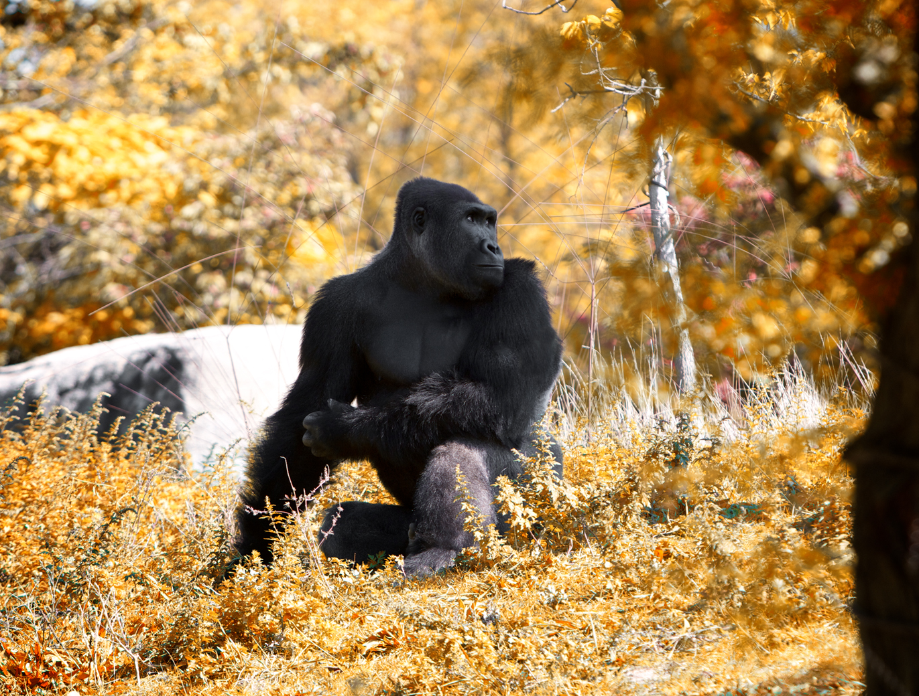
HB-5
Questions

